Slide 1

BIKE -RENTAL PROJECT
Project- P384 Group Number-4
Group Members-
Tejal Singh
Prakash Ravindra Thakur
Rahul Kumar Yadav
Pratik Rathod
Anan Singha Gautam
Prashant Kushwaha

Slide 2
CONTENTS
Business Objective
About Datasets
Exploratory Data Analysis (EDA)
Data Visualisation
Feature Engineering
Model Building
Deployment
Conclusion

Slide 3
BUSINESS OBJECTIVE
The business objective of a bike rental sharing project is to establish a convenient, sustainable, and profitable transportation solution by efficiently managing bike availability, optimizing pricing strategies, enhancing operational processes, ensuring user satisfaction, and fostering growth through data- driven insights and strategic initiatives, ultimately aiming to reduce carbon emissions, alleviate traffic congestion, and provide accessible mobility options for urban and suburban communities.

Slide 4
ABOUT DATASET
The dataset contains features: dteday, season, yr, mnth, hr, holiday, weekday, workingday, weathersit, temp, atemp, hum, windspeed, casual, registered, cnt.
Instant - Index number
Dteday - Date (Format: YYYY-MM-DD)
Season- Season Name
Yr - Year
Month - Month (1-12)(Jan-Dec)
Hr - Hour(0 to 23)
Holiday - Whether the holiday is there or not
Weekday - Day of the week
Workingday -
Weathersit -
Temp - Normalized temperature in Celsius
Atemp - Normalized feeling temperature
Hum - Normalized humidity. The Values are divided by 100
Windspeed - Normalized Wind speed. Values are divided by 67
Casual -Count of casual users
Registered -Number of registered users
Cnt - Count of total rental biked including both casual and registered
Whether it is a working day or not Weather situation

Slide 5
EXPLORATORY DATA ANALYSIS (EDA)
The exploratory data analysis (EDA) phase involved thorough examination and exploration of the dataset to gain insights and understand its characteristics. Key steps in the EDA process included:
Summary Statistics: Calculating summary statistics such as mean, median, standard deviation, and quartiles to describe the central tendency and spread of the data.
Visualization: Creating visualizations such as histograms, boxplots, and scatter plots to visualize the distributions of variables, identify patterns, and explore relationships between features.
Data Cleaning: Handling missing values, outliers, and data inconsistencies through techniques such as imputation, removal, or transformation to ensure the quality and integrity of the data.
Feature Identification: Identifying relevant features and potential predictors that may influence bike rental demand, including temporal factors, weather conditions, and other contextual variables.

Slide 6
Data Visualization
Data visualization played a crucial role in uncovering patterns and relationships within the dataset. Visualization techniques used in this project included:
Time Series Plots : Visualizing trends and seasonality in bike rental counts over time to understand temporal patterns and identify recurring cycles or trends.
Bar Plots : Comparing rental counts across different categorical variables such as seasons, holidays, and weather conditions to assess their impact on rental demand.
Heatmaps : Visualizing correlations between numeric features to identify potential multicollinearity and understand the relationships between variables.
Scatter Plots : Exploring relationships between numeric variables to identify linear
or nonlinear associations and potential predictors of rental demand.

Slide 7
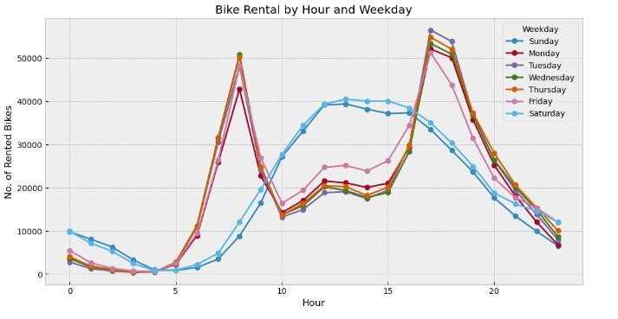
Some Visualizations –
1.
▶

Slide 8
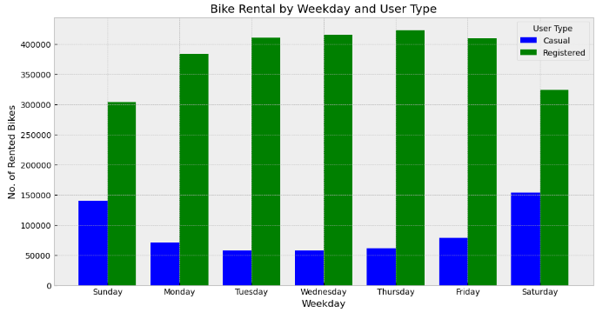
2.

Slide 9
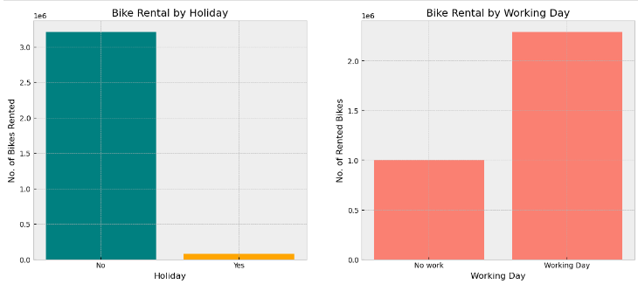
3.

Slide 10
Feature Engineering:
Treating outliers
Encoding Categorical Values
Correlation Coefficient
Normalization of Target Variable
Feature Scaling

Slide 11
Model Building-
Linear Regression : A simple yet powerful regression algorithm used to model the relationship between independent variables and rental demand, assuming a linear relationship.
Decision Trees : Nonlinear models that partition the feature space into regions and make predictions based on the majority class or average target value within each region.
3 . Random Forests : Ensemble models consisting of multiple decision trees trained on random subsets of the data, which aggregate predictions to improve generalization and reduce overfitting.
4. Gradient Boosting (XGB) : Sequential ensemble models that build multiple weak learners iteratively, each focusing on the errors of its predecessor, resulting in a strong predictive model.

Slide 12
Model Evaluation-

Slide 13
Deployment
▶ The final stage of the project involved deploying the trained model as a web application using Flask. The deployed application provides users with an intuitive interface for inputting parameters and obtaining predictions for bike rental demand. Key steps in the deployment process included:
▶ Developing a user-friendly interface for users to interact with the model, allowing them to input relevant parameters such as date, time, and weather conditions.
▶ Implementing backend functionality to process user inputs, generate predictions using the trained model, and display results in a clear and understandable format.
▶ Hosting the web application on a server to ensure accessibility and scalability, enabling
stakeholders to access rental demand forecasts from anywhere with an internet connection.
▶ Conducting thorough testing and validation to ensure the reliability and accuracy of the deployed model, providing users with confidence in the predictions generated by the application.
▶ The deployed web application serves as a valuable tool for stakeholders to make data-driven decisions and optimize bike rental operations effectively.

Slide 14
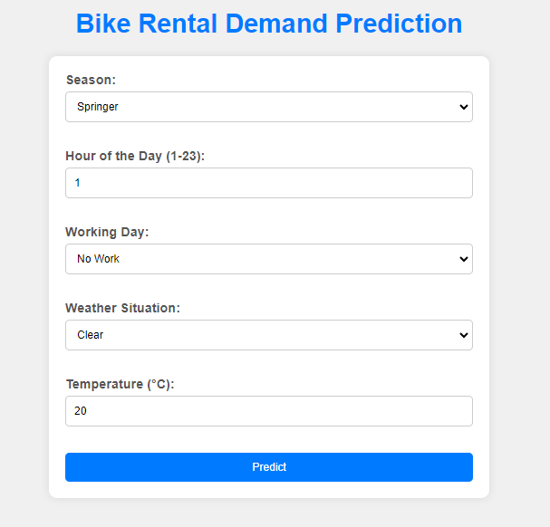
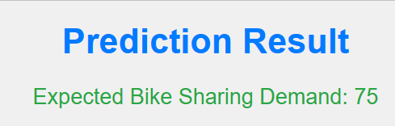

Slide 15


Thank You

